Slide 1


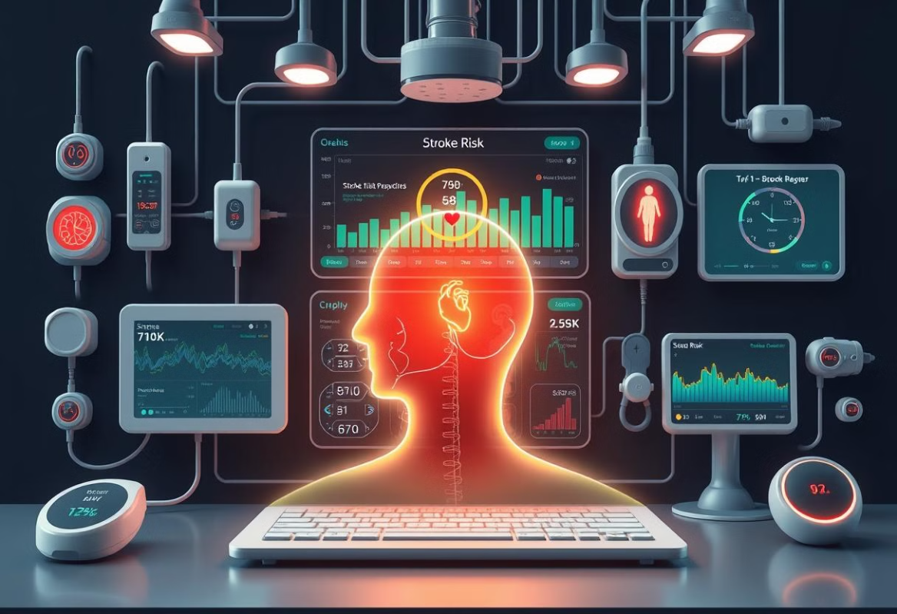
Predicting Cerebrovascular stroke disease related to Heart Disease.
Supervised by: Dr. Hussam Elbehiery
Co-Supervised by: Eng. Ahmed AbdelMoneim

Slide 2
Project’s Team
Name | Department
Ahmed Yasser EL Sharkawy | AI
Ibrahim Ehab Hassan | AI
Ahmed Mohamed Gad Al Mawla | AI
Ahmed Ali Ali Abd Elshafy | AI
Ahmed Amr Afte Deghedy | AI
Arwaa Mohamed Hassan | CS
Sohila Wessam Hamed Refaie | CS
Afnan Fekry Moahmoud Hammad | IS

Slide 3



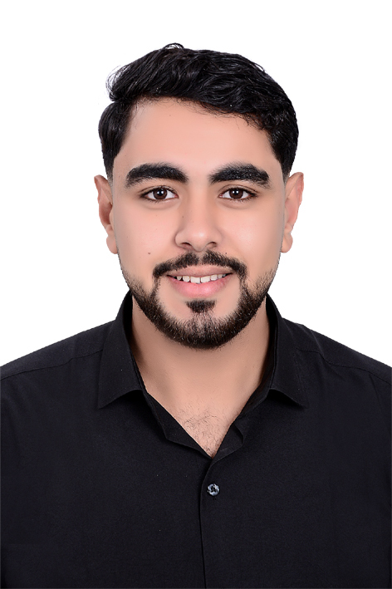

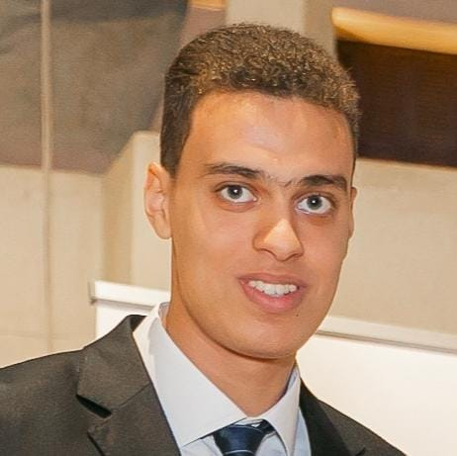


Our Team

Slide 4


01
Introduction
02
Hardware Components
Mobile Application
Agenda
03
04
AI Implementation
05
Conclusion

Slide 5
01
Introduction
02
Hardware Components
02
Suggested Application
Application Designs & methodology
03
03
Mobile Application
Agenda
04
AI Implementation
04
Diagrams
05
Conclusion
05
Conclusion

Slide 6
Introduction: Understanding Stroke and Its Connection to Heart Disease
Stroke is one of the leading causes of death and disability worldwide.
A stroke occurs when blood flow to a part of the brain is interrupted or reduced, preventing brain tissue from getting oxygen and nutrients.
This can lead to serious brain damage, long-term disability, or even death.
Many cases of stroke are linked to underlying heart conditions. Disorders like atrial fibrillation, high blood pressure, and heart failure increase the risk of forming blood clots that can travel to the brain and cause a stroke.
Understanding this strong connection between heart health and brain health is essential for early prevention and effective risk management.

Slide 7
Problem Definition:

Slide 8
Introduction: Advances in Technology
1
2
3
IoT's Rise
AI's Power
A Powerful Combination

Slide 9
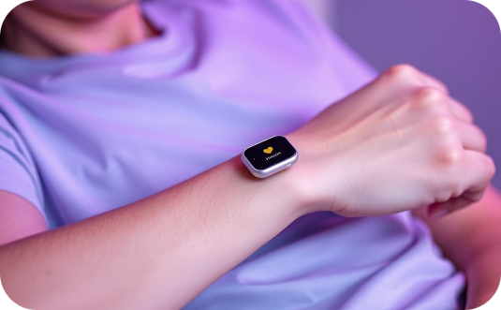
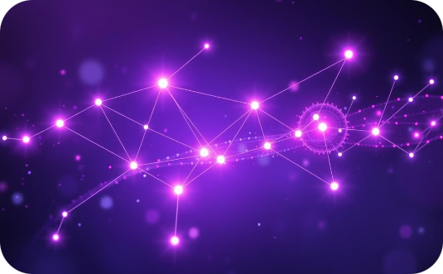
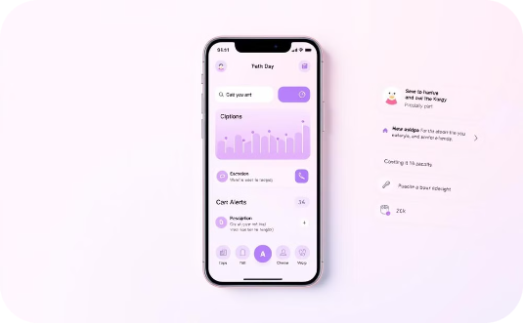
Introduction: Project Objectives
Portable Monitoring
AI-Powered Prediction
User-Friendly App
Convenient, non-invasive vital signs monitoring (heart rate, blood pressure, blood oxygen).
Employ AI to predict stroke risk using collected data, providing timely alerts.
User-friendly mobile app for data review, alerts, educational resources, and communication with healthcare providers.

Slide 10
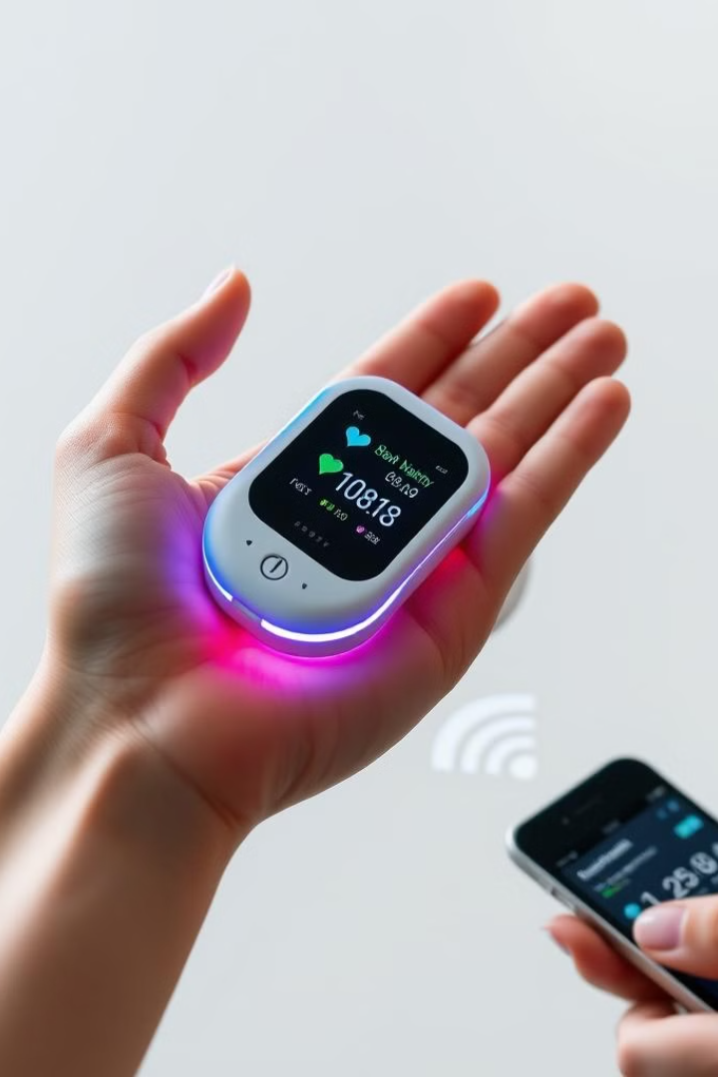
System Overview: Unique Features
Portable and Cost-Effective Design
AI-Driven Insights
Provides personalized health monitoring.
Ensures accessibility and affordability.
Seamless Integration
Hardware and software work together flawlessly.

Slide 11
Workflow: Step-by-Step Process
Sensors Capture Data
1
Heart rate, blood oxygen, and heart activity are measured and turned into digital signals.
2
Arduino Processes Data
The Arduino receives the data, cleans it up, does calculations, and prepares it for sending.
Data Transmission and Display
3
The data shows up on the screen and is sent wirelessly to your phone app.
4
Result Display
The app displays the analysis results from the AI model.
Data Storage
5
The app saves your data for later use.

Slide 12
01
01
Introduction and Workflow
Introduction
02
Hardware Components
02
Suggested Application
Application Designs & methodology
03
03
Mobile Application
Agenda
04
AI Implementation
04
Diagrams
05
Conclusion
05
Conclusion

Slide 13
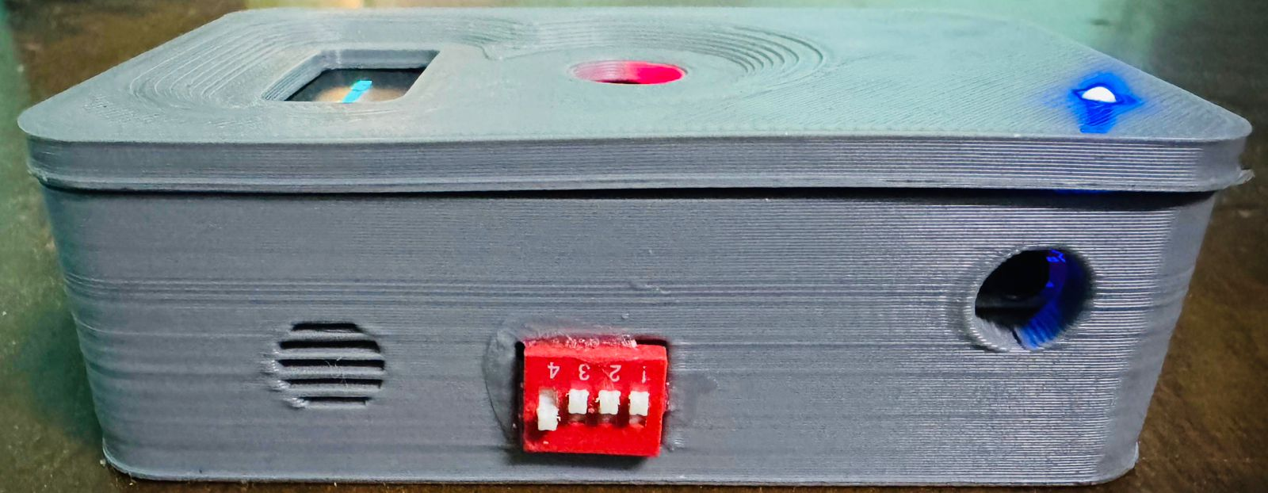
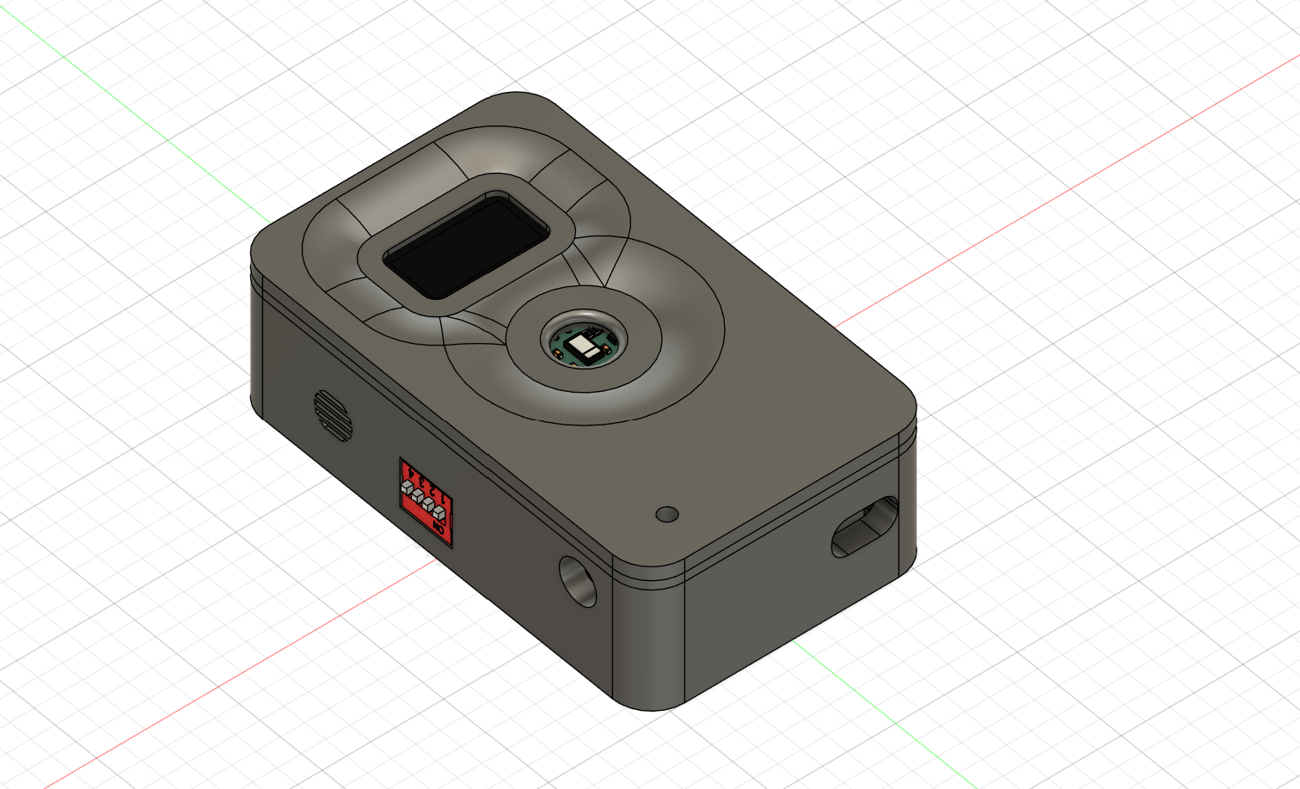
Hardware: Overview
A smart system using Arduino to monitor vital signs.
It provides early warnings for potential stroke risk.

Slide 14
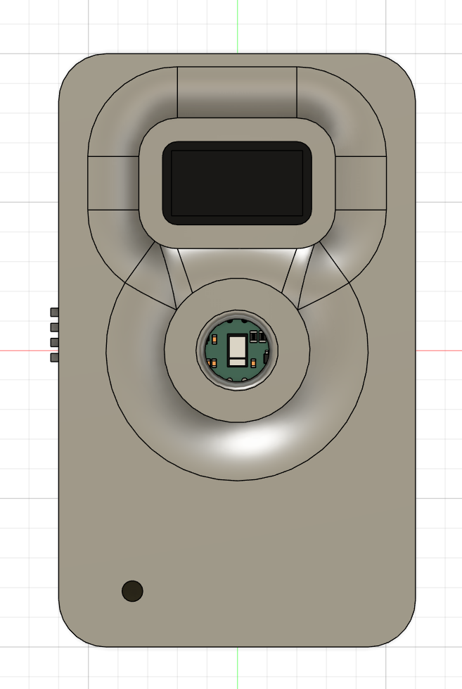
Hardware: Custom 3D Case
.
Custom casing made with 3D printing for durability.
Allows easy prototyping and component protection

Slide 15
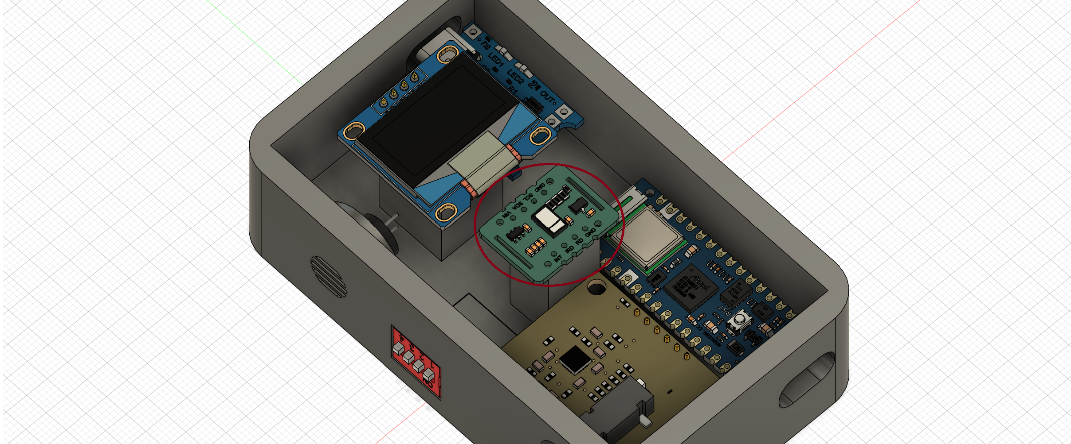
Hardware: MAX30102 Sensor
Measures heartbeats per minute, indicating heart health
Normal range is 60–100 BPM; irregular rates may signal risks.
.

Slide 16
Hardware: MAX30102 Sensor
Shows oxygen saturation in blood, normally 95–100%.
Low levels may indicate health problems or stroke risk.

Slide 17
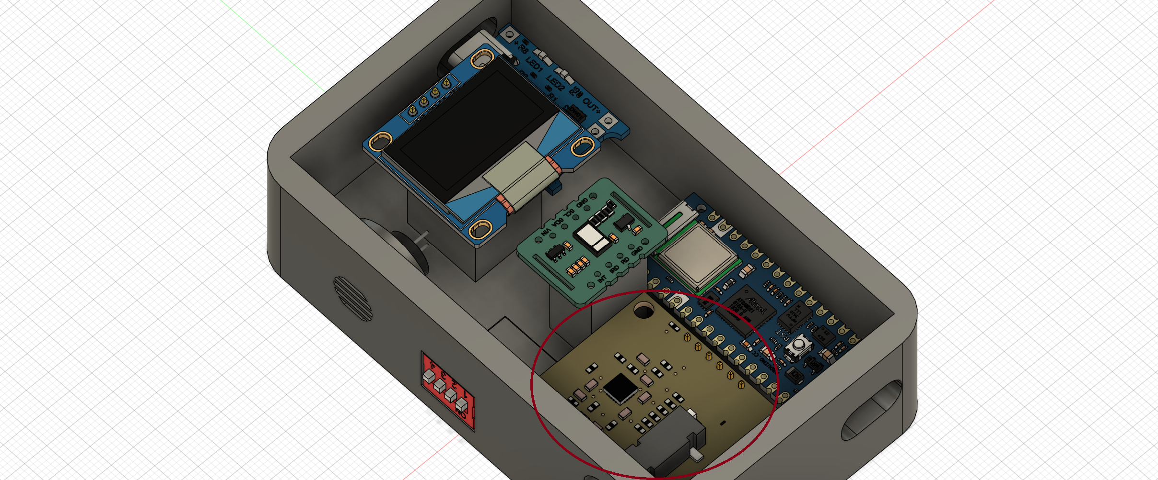
Hardware: ECG Sensor
Records the heart’s electrical activity to detect irregularities.
Certain patterns can signal stroke risk or heart issues..

Slide 18
Hardware: Wireless Monitoring<<BLE>>
Sends real-time health data wirelessly to mobile devices.
Enables apps to monitor :
BPM live
SpO2 live
ECG live

Slide 19
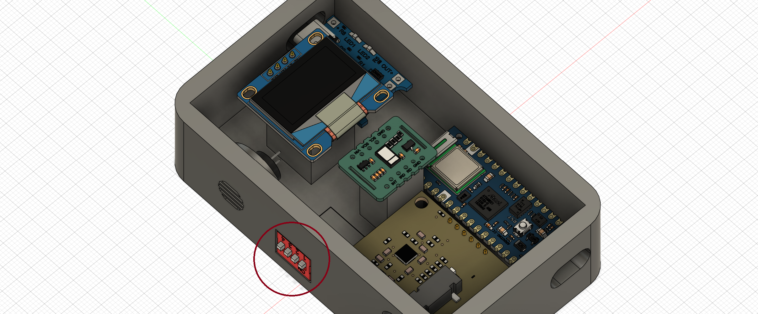
Hardware: Control Buttons
Four buttons control the device’s functions and power.
Each button activates a specific sensor or powers the device.

Slide 20
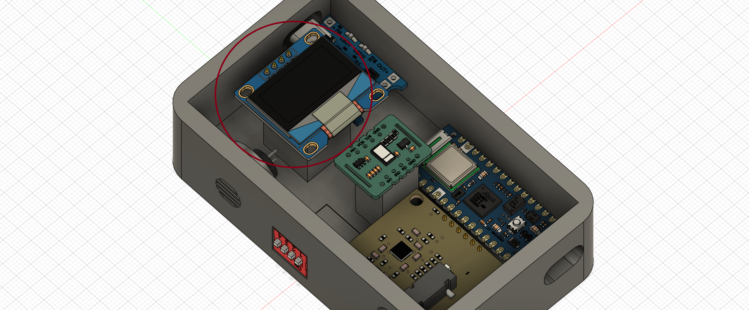
Hardware: OLED screen
Sensor data shown clearly on OLED screen
Buzzer beeps with each heartbeat for real-time alerts

Slide 21
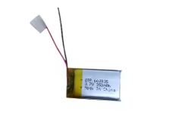
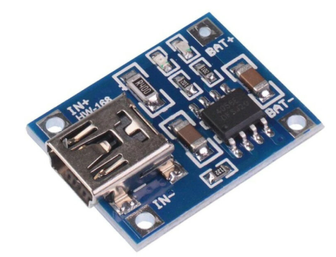
Hardware: Power Supply
Powered by a 350mAh rechargeable lithium battery.
Provides portability and long monitoring time.

Slide 22
01
01
Introduction
Introduction and Workflow
02
Hardware Components
02
02
Hardware Components
Suggested Application
Mobile Application
Agenda
03
04
AI Implementation
05
Conclusion

Slide 23
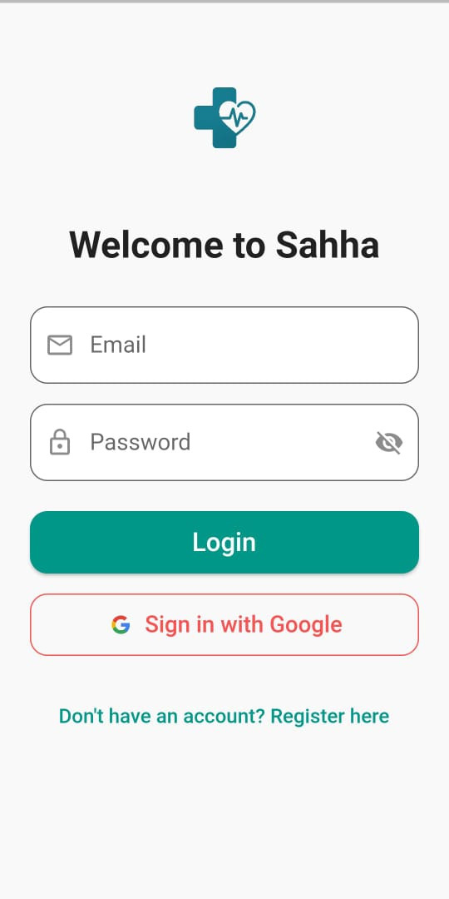
Login & Authentication:
Users can log in using email/password or with Google.
This helps the user log in easily and safely.

Slide 24
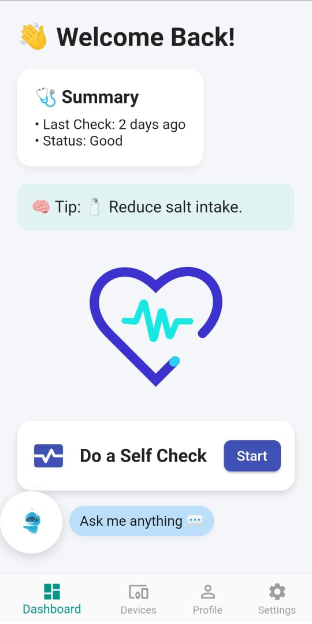
Dashboard:
After login, the user sees this screen.
It shows the last health check and a health tip.
The user can press the button to do a new check.

Slide 25
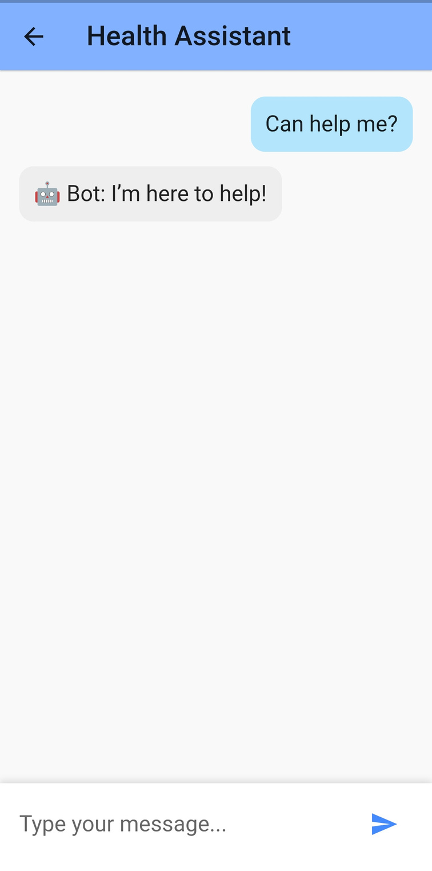
Chatbot Assistant:
This is the virtual assistant inside the app.
It helps the user by answering questions about their health.
It also gives useful tips and explains results in a simple way.

Slide 26
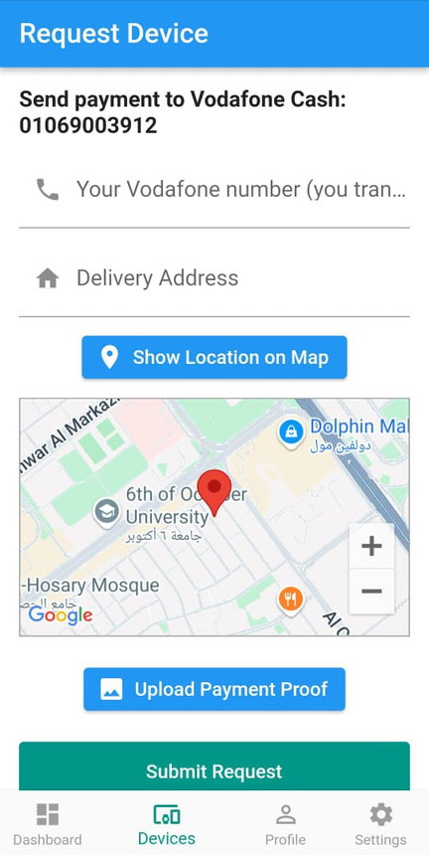
Request Device:
If the user doesn’t have a device, they can order one here.
They write their address, phone number, and upload payment proof.
They can also share their location.

Slide 27
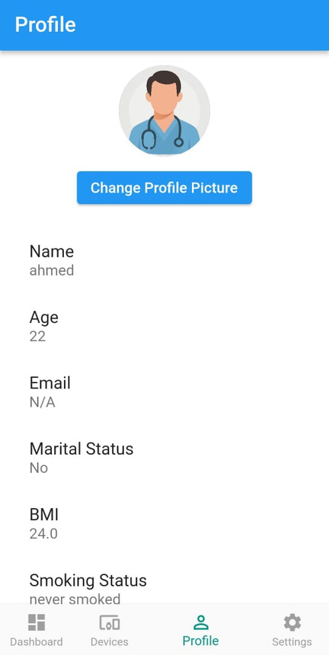
Profile:
The profile shows the user’s info Like: name, age, BMI, and if they smoke
This info is used in the health check.

Slide 28
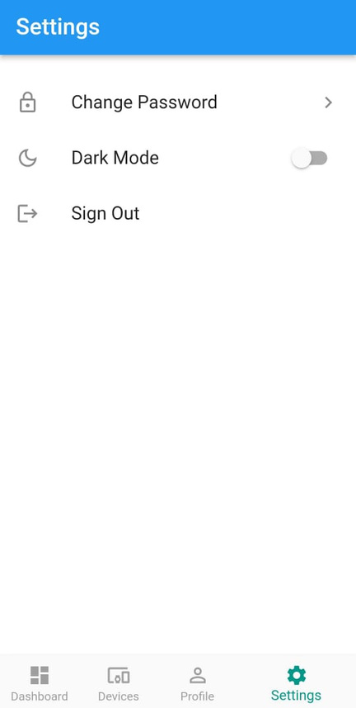
Settings:
The user can change password, turn on dark mode, or sign out.
It’s simple and useful.

Slide 29
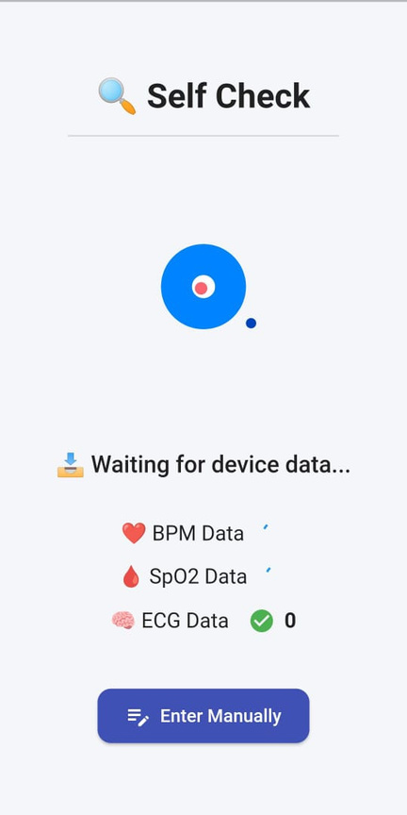
Self Check (with Device):
The app connects to a health device using Bluetooth.
It gets live data like heart rate, oxygen, and ECG.
This data helps the app check the stroke risk.

Slide 30
How the App Works:
1.The app gets health data from the device and the users
2.Then it sends the data to an AI system.
3.The AI checks if the user is in danger of stroke.
4.It gives the result back to the app.

Slide 31

01
01
Introduction
Introduction and Workflow
02
Hardware Components
02
02
Hardware Components
Suggested Application
Mobile Application
03
Agenda
03
Mobile Application
04
Diagrams
04
AI Implementation
05
Conclusion

Slide 32
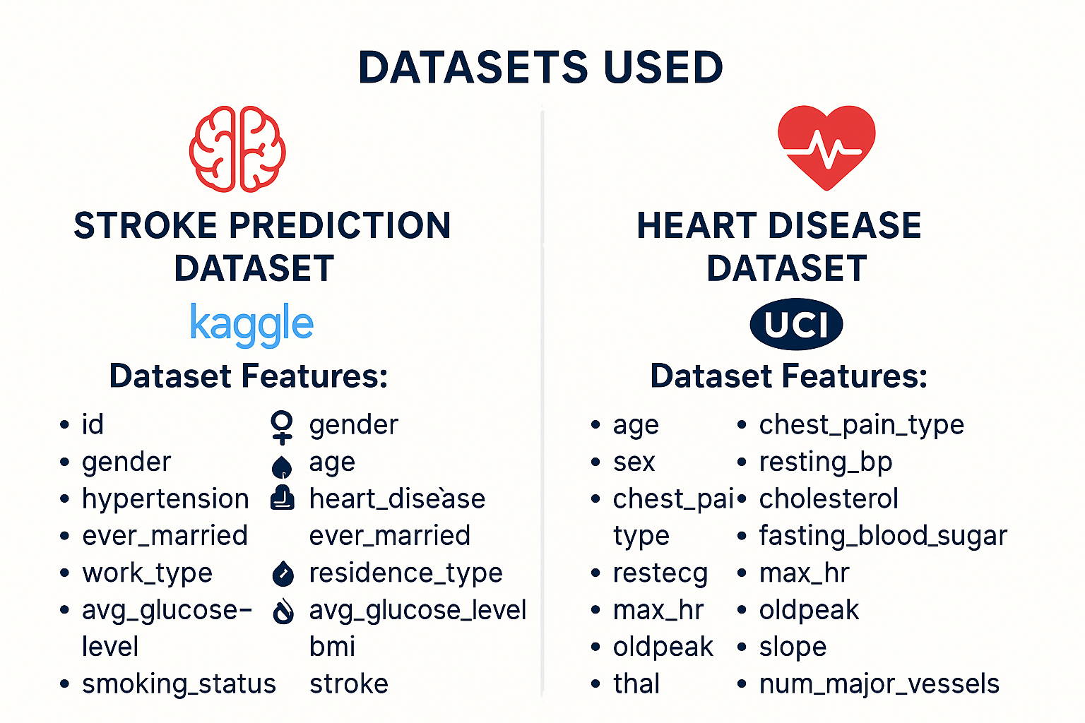

Slide 33
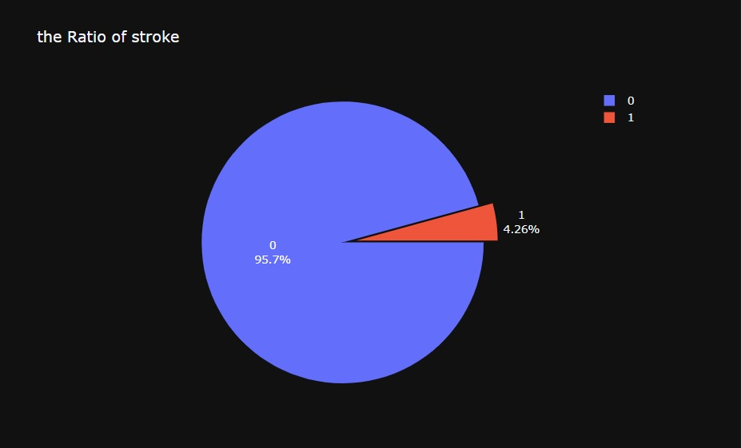
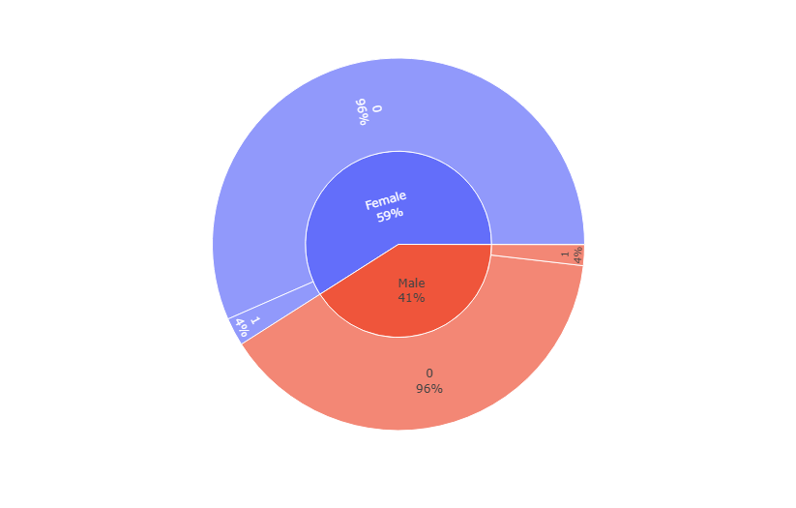
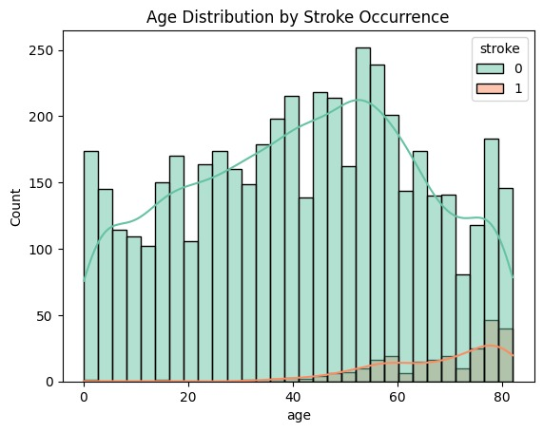
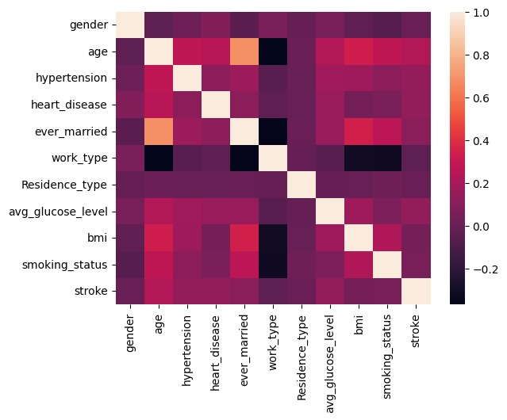
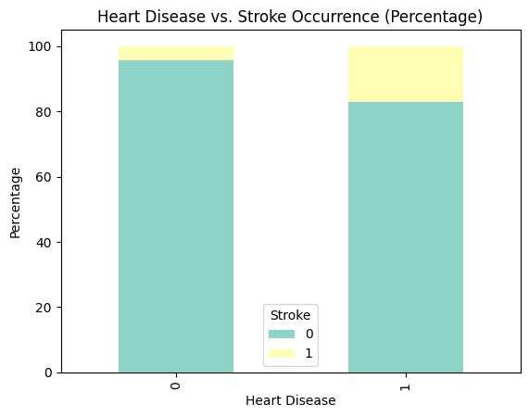
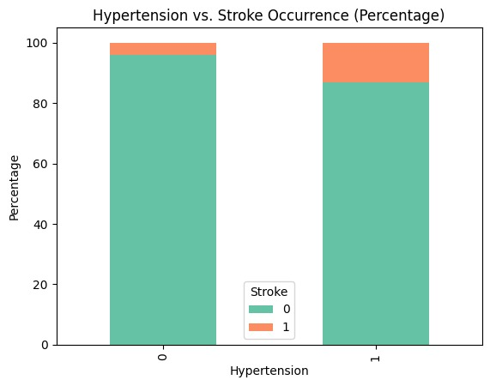
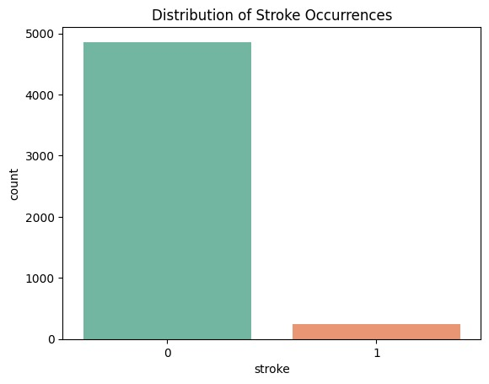
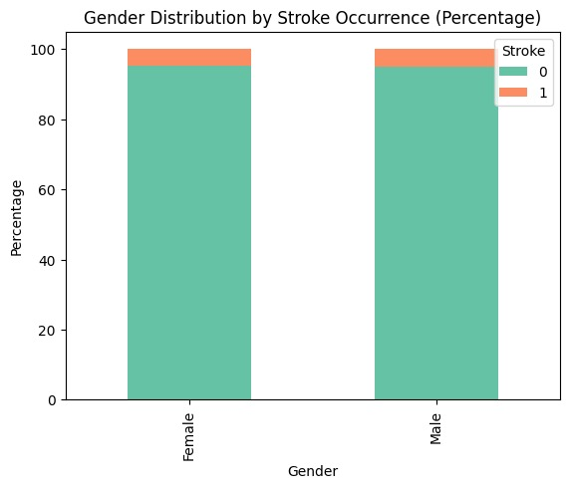
Exploratory Data Analysis
What is the relationship between hypertension and stroke?
How does heart disease relate to stroke occurrence?
What is the distribution of stroke occurrences?
Is there a gender difference in stroke occurrence?
How does age distribution differ between those who had a stroke and those who didn’t?
distribution of stroke
1
distribution Gender With Stroke
2
Age distribution With Stroke
3
Hypertension
4
Heart Disease
5
Heatmap Correlation
6

Slide 34
Model Architecture
exang
Max hr
restecg
Resting blood pressure
Work
Type
Ever
Married
Avg Glucose Level
oldpeak
Chest pain type
hypertension
BMI
slope
Sex
Gender
thal
Smoking Status
Heart Model
Age
Stroke Model
Stroke prediction
Heart disease

Slide 35
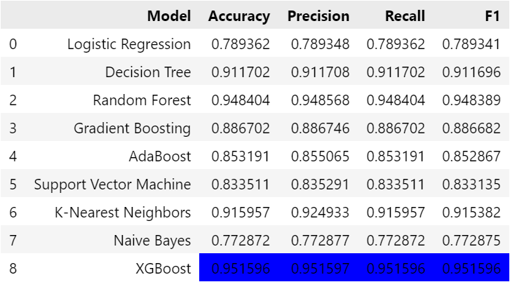
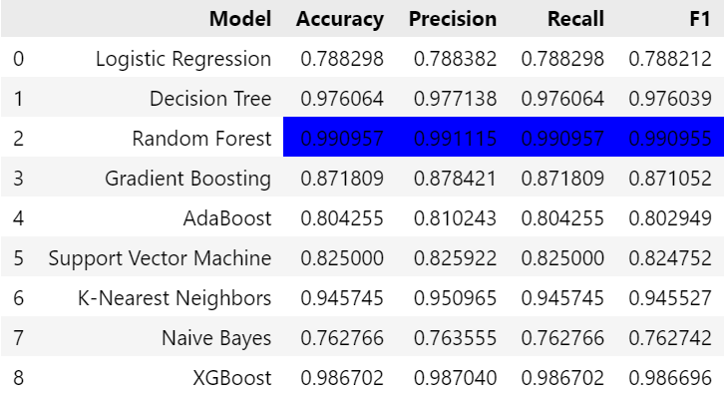
Solution to Deal with Imbalanced Data
Resampling data by SMOTE
Random Oversampling

Slide 36
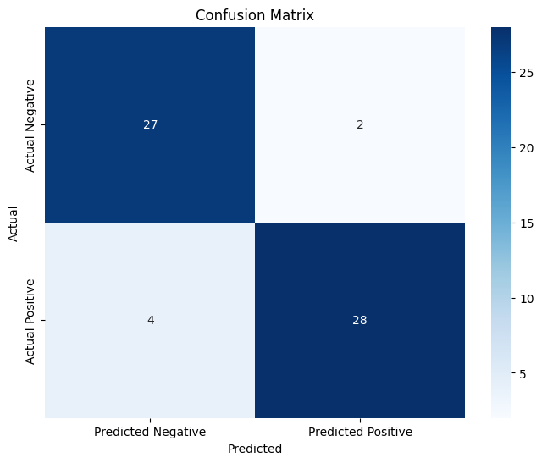
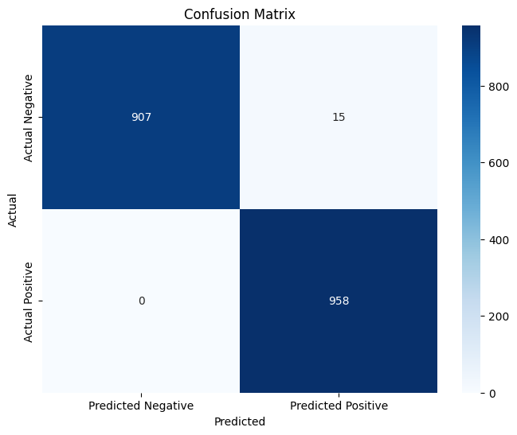
Results of Models
Heart disease Model
Stroke disease Model

Slide 37
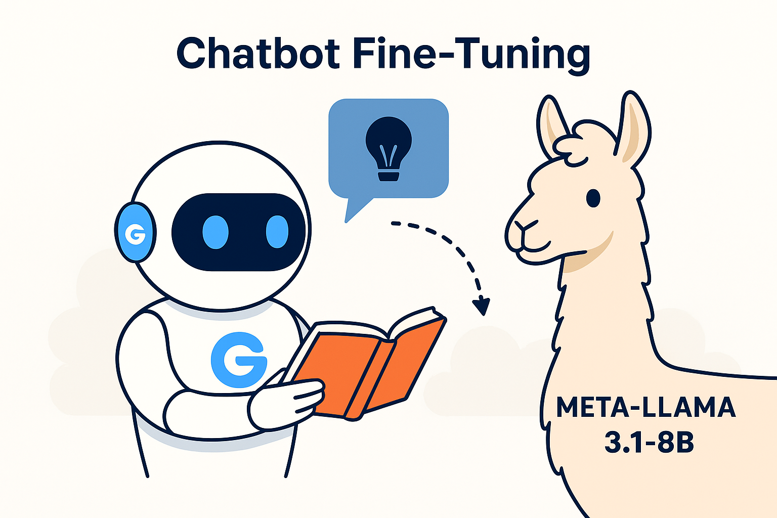
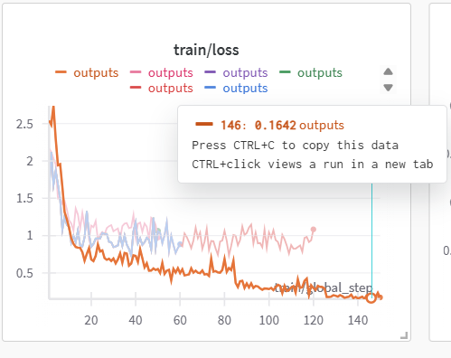
Chatbot Fine-Tuning

Slide 38
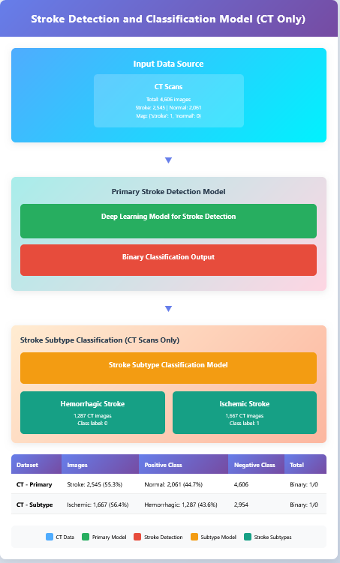
Computer Vision Model

Slide 39
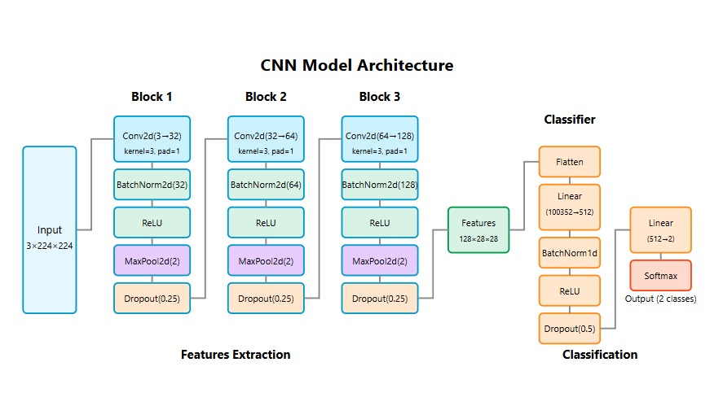

Slide 40
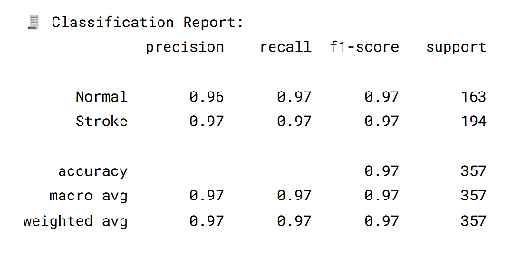
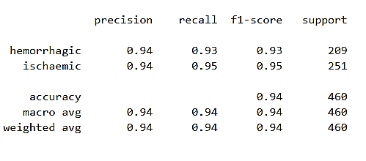
Results of Computer Vision Model
Main Model
Sub Model

Slide 41
01
01
Introduction
Introduction and Workflow
02
Hardware Components
02
02
Hardware Components
Suggested Application
Mobile Application
03
Agenda
03
Mobile Application
04
AI Implementation
05
Conclusion

Slide 42
Conclusion
We plan to launch our application on Google Play, aiming for positive feedback and a broad
impact on stroke prediction and prevention.
We would also like to extend our heartfelt thanks to Dr. Hussam Elbehiery
for his invaluable guidance throughout this project."

Slide 43
THANK YOU

Slide 44
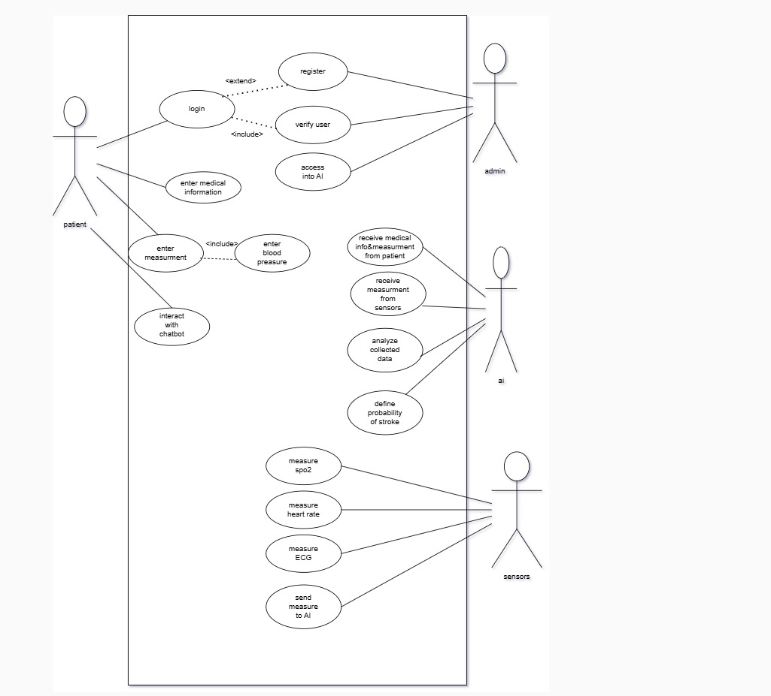
Use case Diagram

Slide 45
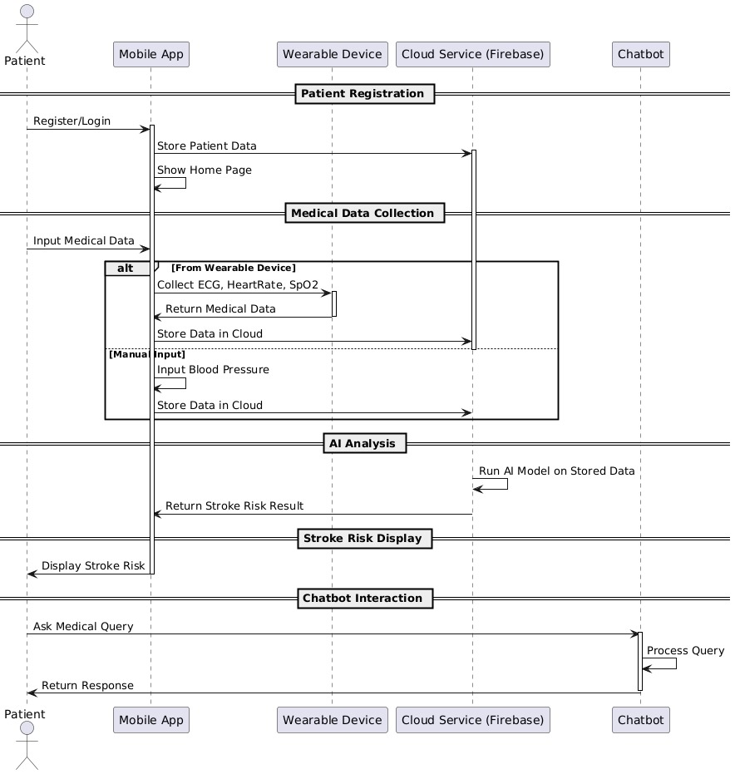
Sequence Diagram

Slide 46
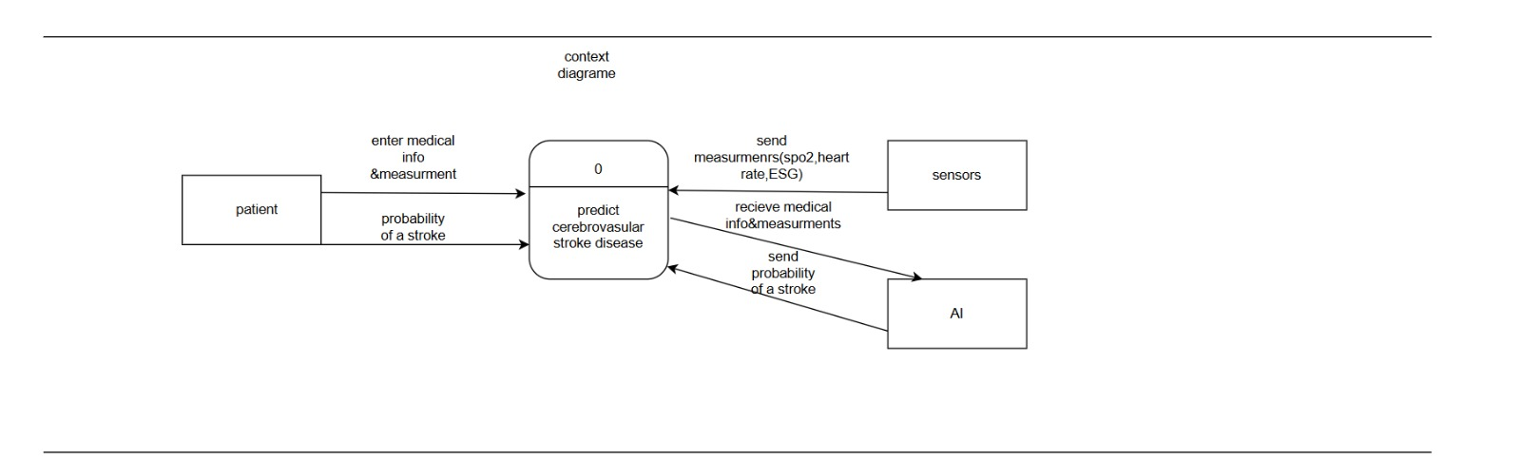
Data Flow Diagram (DFD ) Context Diagram

Slide 47
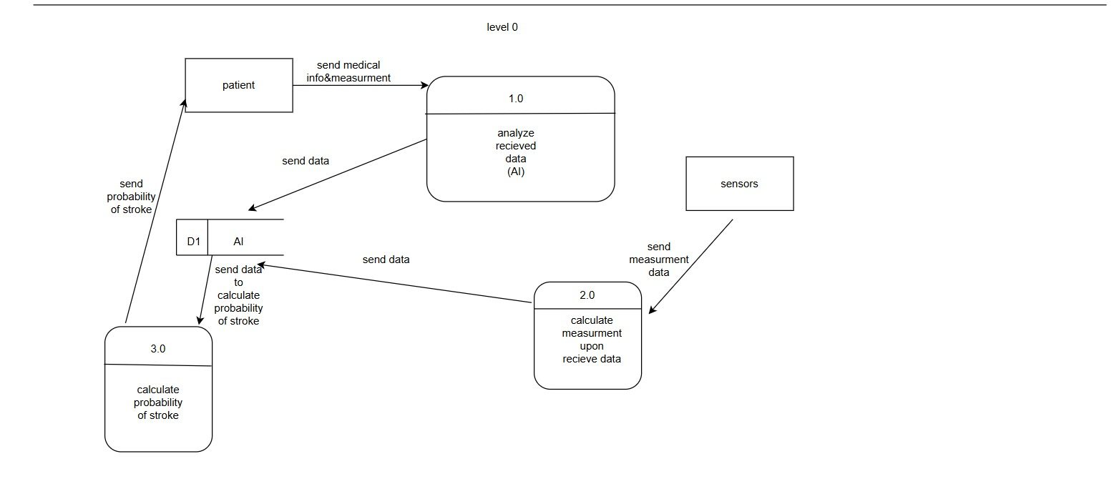
Data Flow Diagram (DFD) Level 0

Slide 48
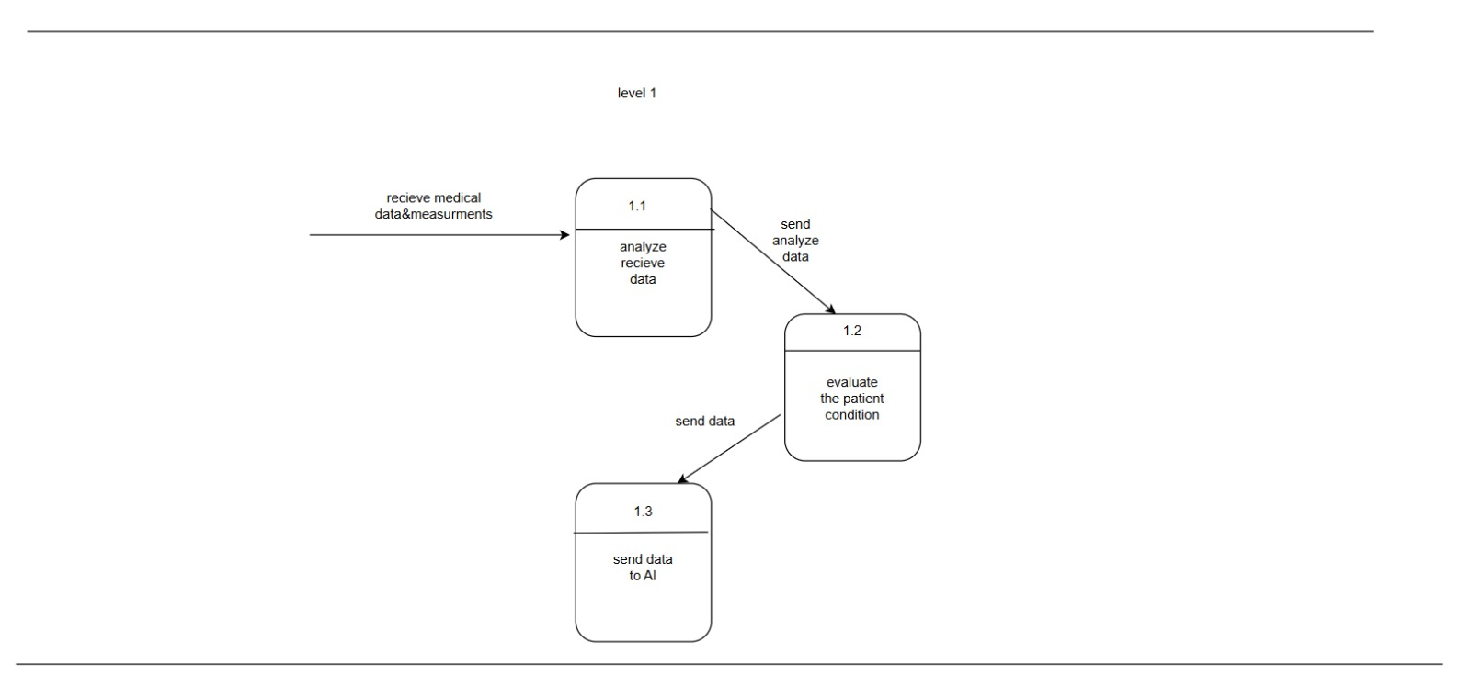
Data Flow Diagram (DFD) Level 1

Slide 49
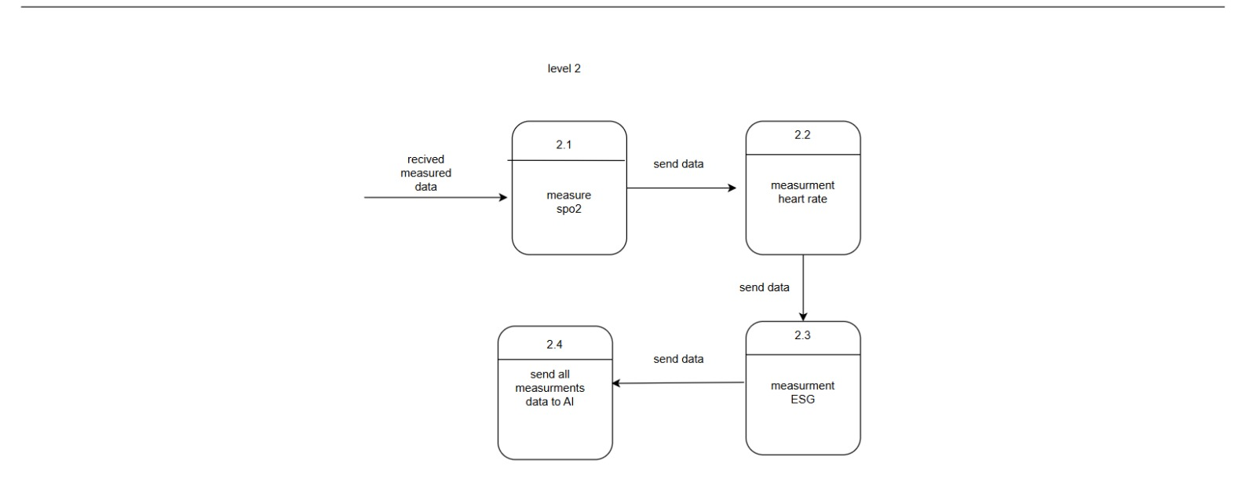
Data Flow Diagram (DFD) Level 2

Slide 50
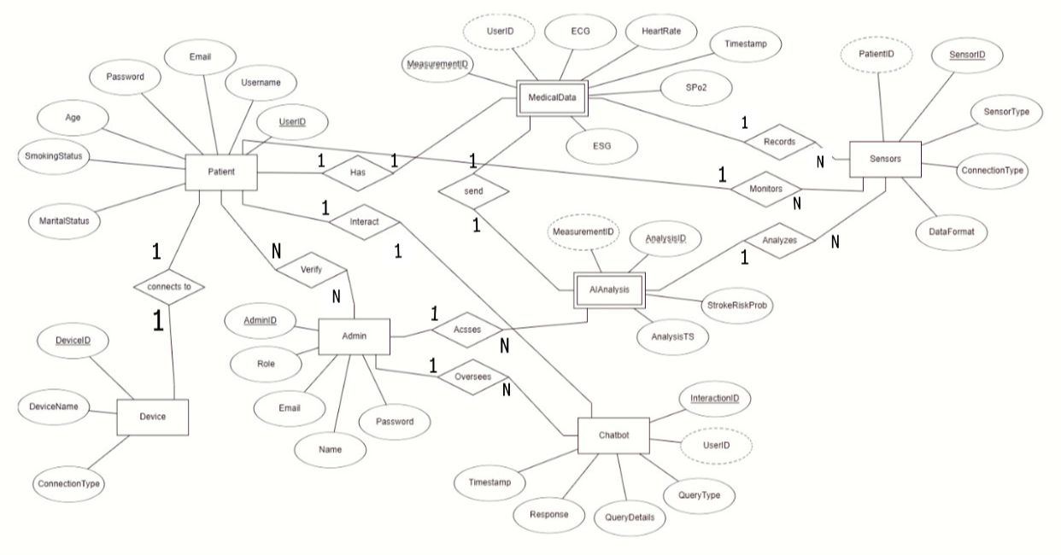
ERD Diagram

Slide 51
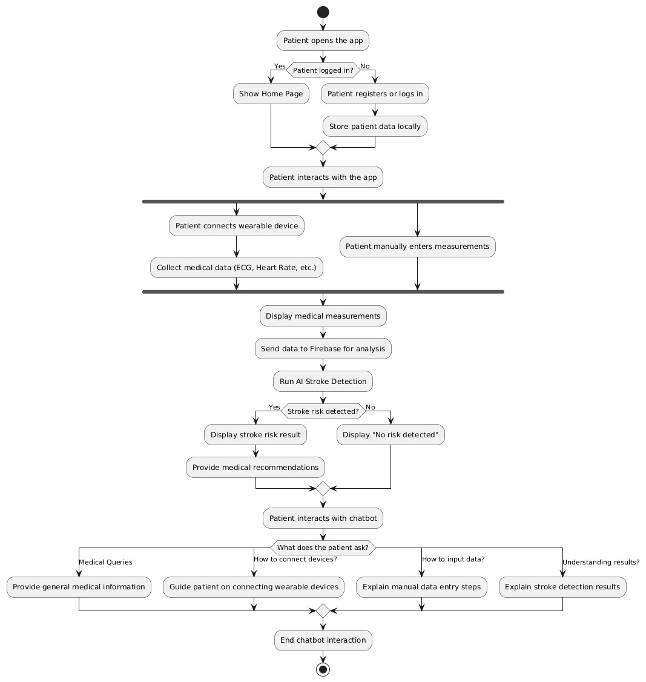
Patient Activity Diagram

Slide 52

Admin Activity Diagram

